Slide 1
C Tutorial (2)
Structures

Slide 2
Outline
The binary tree example
C vs Java
When the nodes of a tree are dynamic data
Structure variables
Pass by value and pass by reference

Slide 3
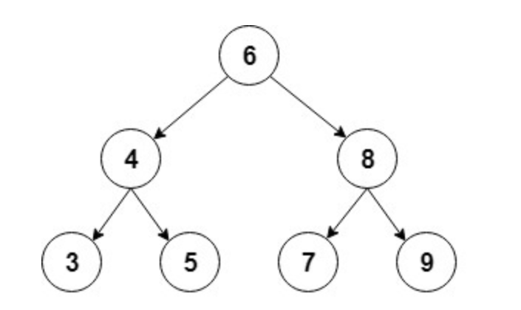
Binary Tree
The root of the tree identifies the tree
leftChild < parent
rightChild > parent
Operations on a node:
Add a child
Remove a child
Operations on a tree:
Add a node
Remove a node
Search for a node
And many more
Hint: a new node added to a tree always ends up to be a leaf.
root

Slide 4
How is C different from Java? (binary tree example)
class Node {
int value;
Node leftChild;
Node rightChild;
Node (int value) { …}
…
}
class binaryTree {
Node root;
binaryTree (int value) {…}
void add (int value) {…}
void remove (int value) {…}
Bool contain (int value) {…}
void printTree () {…}
}
struct Node {
int value;
struct Node* leftChild;
struct Node* rightChild;
};
struct bTree {
struct Node * root;
};
struct bTree* newTree (int value) {..}
int add (struct bTree* root, int value) {…}
int remove (struct bTree* root, int value) { … }
int contain (struct bTree* root, int value) { … }
int printTree (struct bTree* root) {…}

Slide 5
Tree nodes are dynamic data
struct Node* newNode (int value) {
struct Node* this = (struct Node*)malloc(sizeof(struct Node));
if (this == NULL) {
return NULL; //malloc out of memory
this -> value = value;
this -> leftChild = NULL;
this -> rightChild = NULL;
return this;
}

Slide 6
The differences between Java and C
C uses pointer; Java does not
Java associates methods with data structure; C does not
Java throws exceptions; C returns error values
Java encapsulates variables better than C
What are the implications of the above?

Slide 7
Structure variables
struct Node { int value;
Node* leftChild;
Node* rightChild;
} n1, n2, *root;
struct Node n1, n2, *root; // same as above
n1.value = 123; n1.leftChild = &n2; n1.rightChild = NULL; //member access from a variable
n1 = {123, &n2, NULL} // same as above
root = &n2; root-> value = 121; // n2.value is 121; member access from a pointer
struct Node manyNodes [100]; manyNodes [2].value = 120;

Slide 8
Structures and functions
Pass by value
struct Node isParent (struct Node child) { … }
Pass by reference (pointer)
int isParent (struct Node* parent, struct Node child) { … }
Which one is better?

